Slide 1
Time is Money
By: Mitchell Berberick, Madison Fluckey, Jacob Barrington

Slide 2


Slide 3


Slide 4


Slide 5
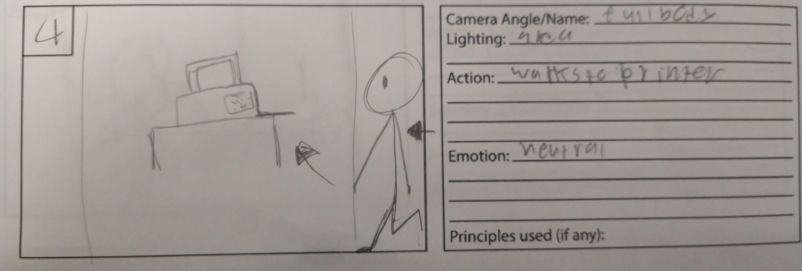

Slide 6


Slide 7
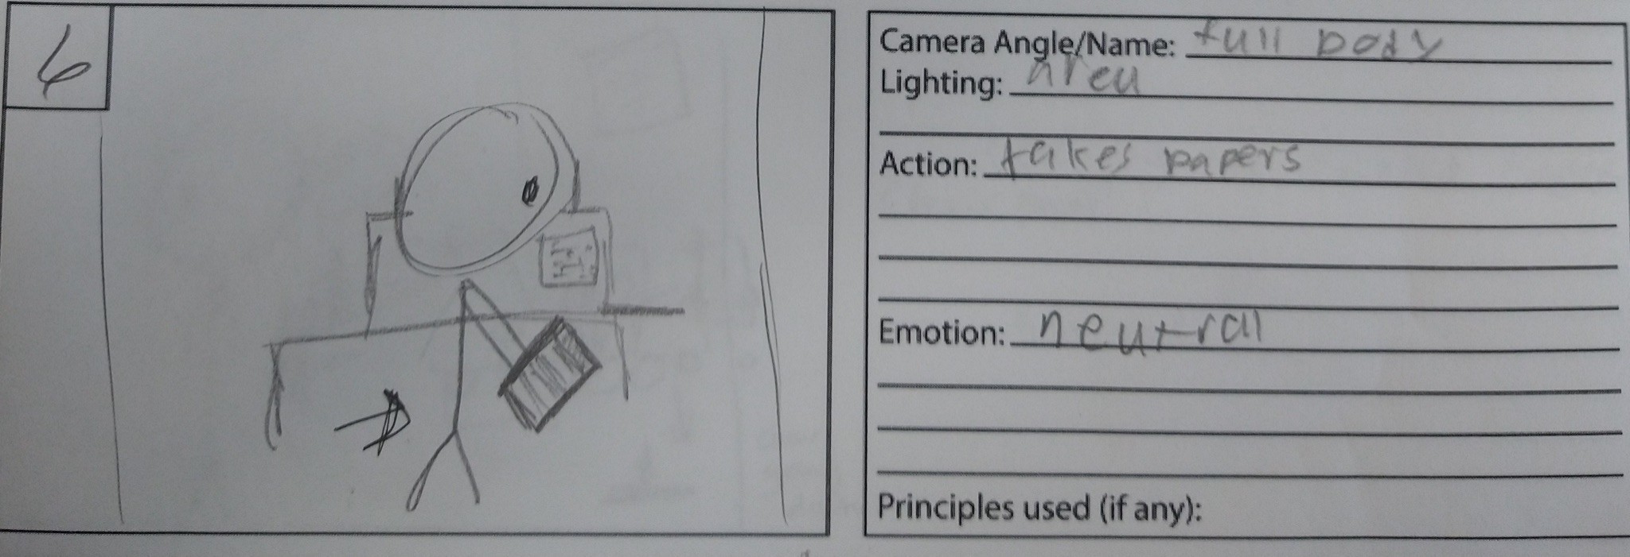

Slide 8
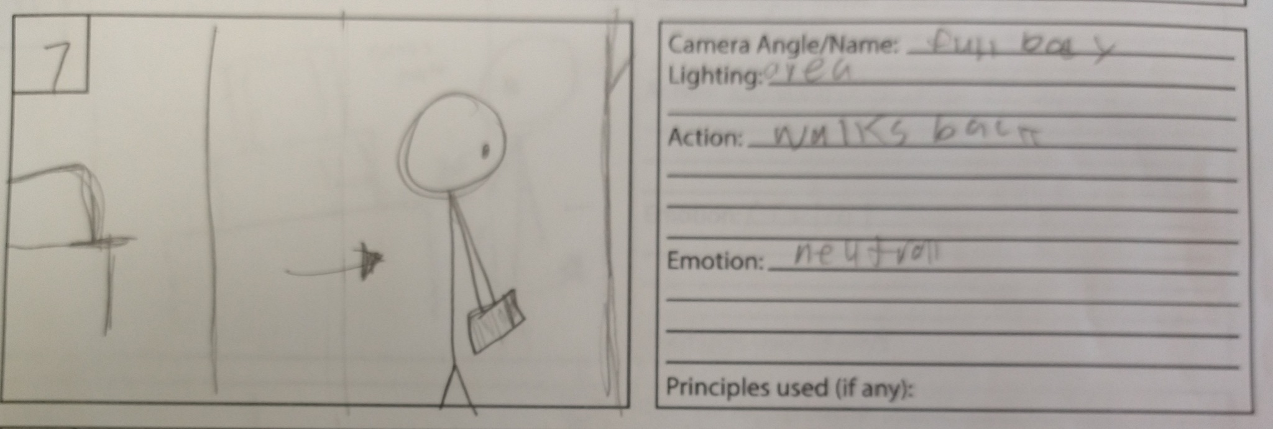

Slide 9


Slide 10


Slide 11
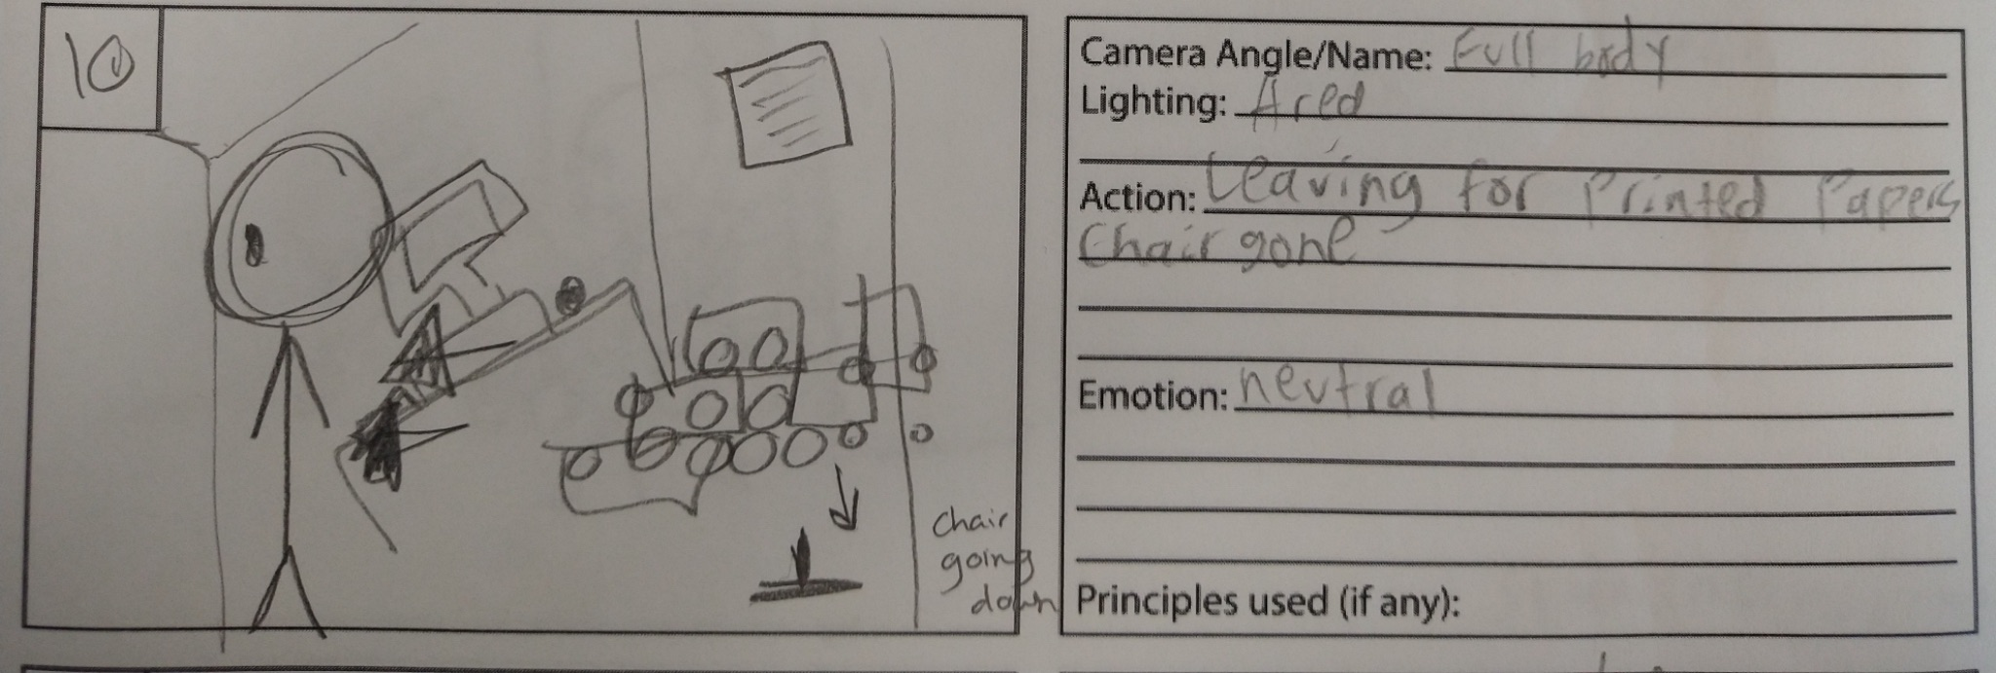

Slide 12


Slide 13


Slide 14


Slide 15
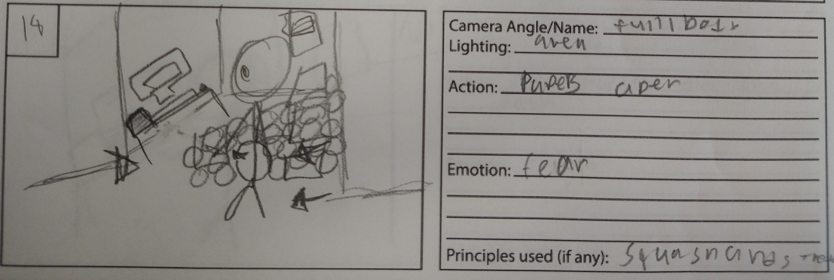
Walking back for last time

Slide 16


Slide 17
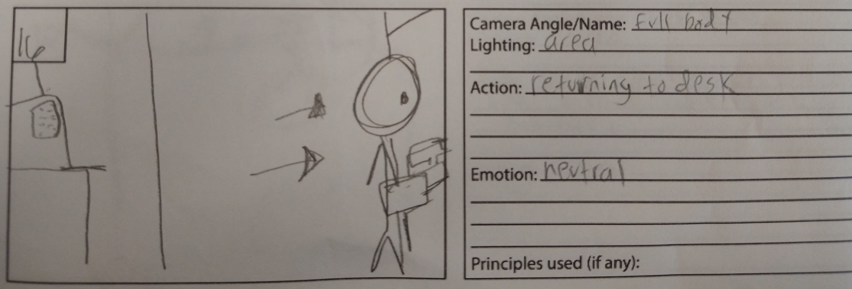

Slide 18


Slide 19


Slide 20


Slide 21
